Slide 1
CS112 : Introduction to Python Programming
Week 8: lab practice

Slide 2
Practice 1
Write a reverse complement function that takes a DNA sequence and returns the reverse complement sequence in upper cases
E.g.
>>>reverse_comp(‘AtCg’)
CGAT

Slide 3
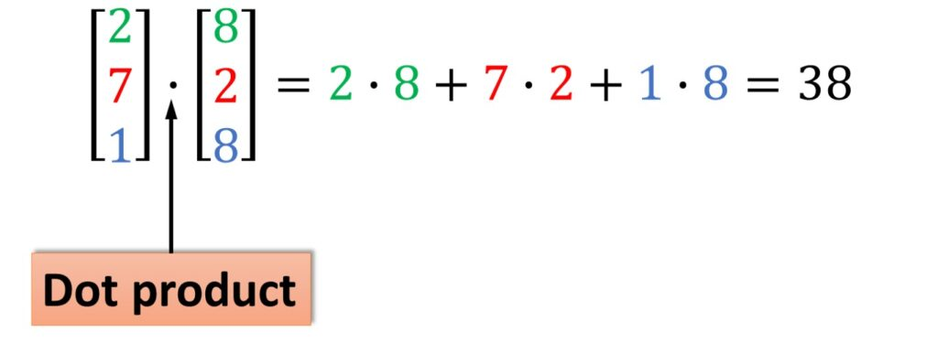
Practice 2
Write a dot product function that takes two vectors and returns the dot product of the two vectors. The vectors can be in any length.

Slide 4
Practice 3
Write a get_max() function to return the max value of a given list of numbers.
Do not use the max() built-in function
>>>get_max([1, 2, 3])
3

Slide 5
Practice 4
Write a function that could accept a variable number of values and calculate their product.

Slide 6
Practice 5
Write a function to return the n^{th} Fibonacci number using recursion.
Hint: Fibonacci(n) = Fibonacci(n-1) + Fibonacci(n-2)

Slide 7
Practice 6
Write a Python function that accepts a string and calculate the number of upper case letters and lower case letters.

Slide 8
Practice 7
Write a Python function to check whether a number is perfect or not.
A perfect number is a positive integer that is equal to the sum of its proper positive divisors (excluding itself).
For example:
The first perfect number is 6, because 1, 2, and 3 are its proper positive divisors, and 1 + 2 + 3 = 6.
The next perfect number is 28 = 1 + 2 + 4 + 7 + 14. This is followed by the perfect numbers 496 and 8128.

